Slide 1


Improving the Detection of Small Oriented Objects in Aerial Images
01
Ayush Bilkhiwal (CS23M119)
Nitesh Yadav(CS23M110)

Slide 2
Problem Statement
Addresses the challenge of accurately detecting small oriented objects, such as vehicles, infrastructure, or natural features in aerial images.

Slide 3
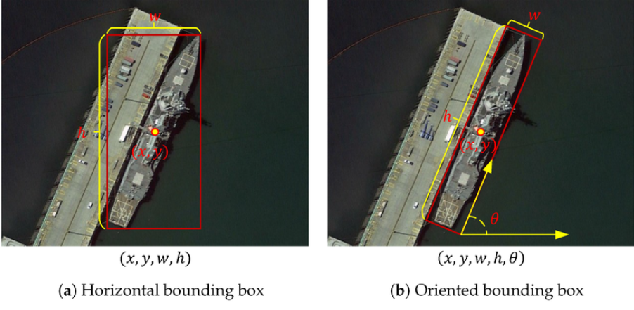
Previously Used Methods

Slide 4
MOTIVATION
Traditional object detection methods may struggle to accurately identify small objects, especially if they are oriented at different angles or are within cluttered backgrounds. These challenges can hinder the performance of automated systems relying on aerial imagery.

Slide 5
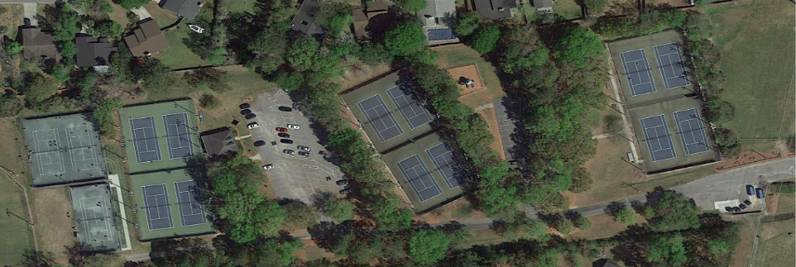
What this paper is about

Slide 6
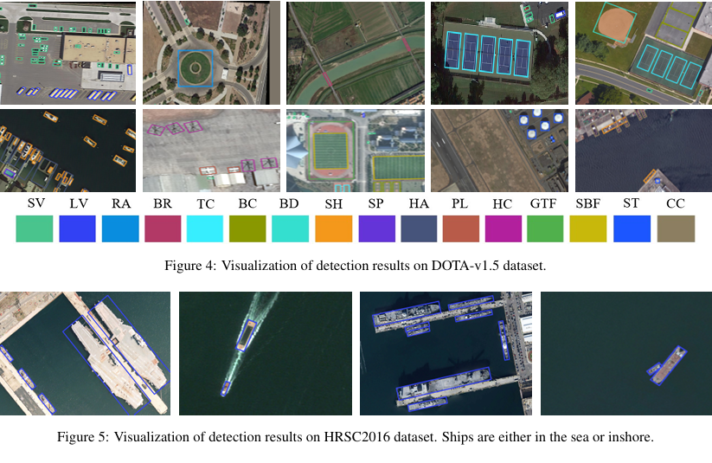
What this paper is about

Slide 7
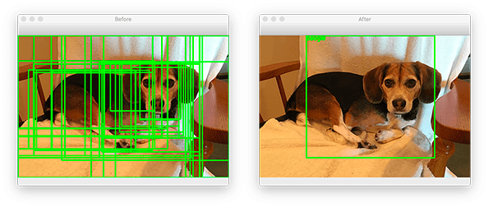
Different approaches to object detection using bounding boxes, classification, and region proposal generation.
Generating Region Proposals
Oriented Proposals

Slide 8
Proposed the ATTENTION POINTS NETWORK to detect the small oriented objects in aerial images.
Used attention mechanism to gather the important features of an object, which increases the model’s awareness especially on hard-to-identify objects such as small and complex instances.
They designed two loss functions:
Guided-Attention Loss (GALoss)
Box-Points Loss (BPLoss).

Slide 9
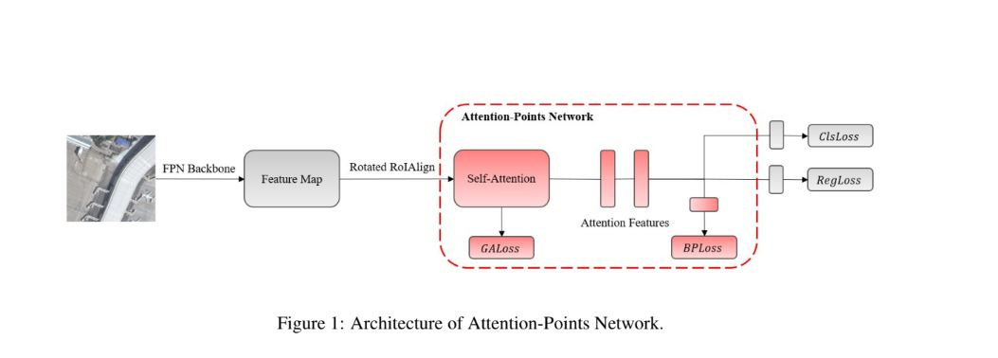
FPN ="Feature Pyramid Network “

Slide 10
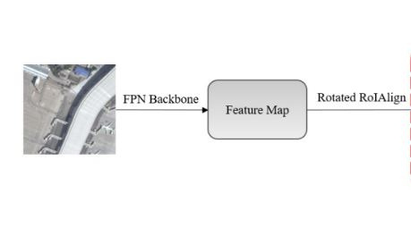
Two-stage object detection system.
In the first stage, the system extracts features from the input images.
The backbone network used for feature extraction is ResNet

Slide 11
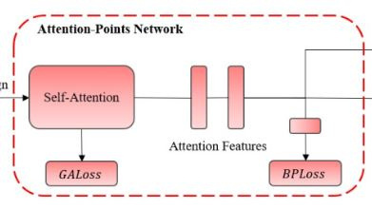
Adaptive Proposal Network (APN): It adapts the proposals based on certain criteria, which could include refining the proposals or adjusting their shapes for better detection accuracy.

Slide 12
Self-Attention Mechanism:
Finally, the features extracted from the adapted proposals are used as input to a self-attention mechanism. This mechanism focuses on specific regions of interest within the image, helping the system to prioritize important features for accurate object detection.

Slide 13
GUIDED-ATTENTION LOSS (GALOSS)
GALoss compares the attention features to target features that can be obtained using the instance segmentation masks.
Steps:
ROI(Region of Interest) processed by self attention to obtain rich attention feature.
Then used binary cross entropy to compare similarity between feature and mask.

Slide 14
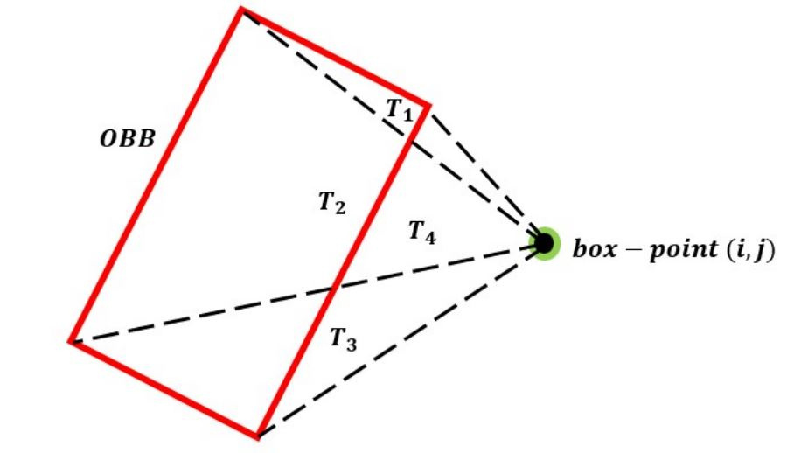
BOX POINT LOSS

Slide 15
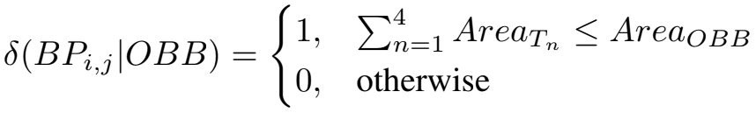
BOX POINT LOSS
If the sum of the areas of the triangles
is less than or equal to the AreaOBB, this means the BP is
inside the OBB, otherwise it is outside.

Slide 16
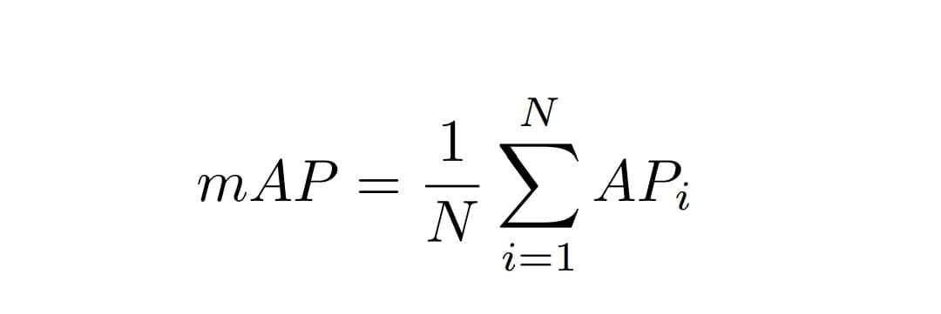
Evaluation
The mean average precision (mAP) is used as the evaluation metric for detecting score on small oriented objects.
The mAP is calculated based on the intersection over union (IoU) between ground-truth and predicted bounding boxes.
If the IoU is greater than the threshold, the prediction is TP, otherwise, it is FP.

Slide 17
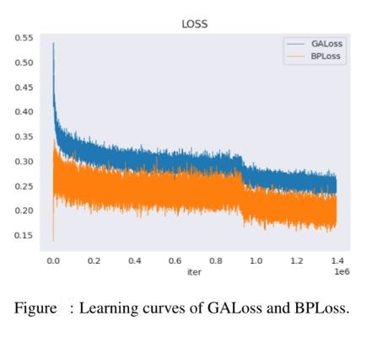
The learning curves over the number of iterations
and showed that GALoss and BPLoss are decreasing,

Slide 18
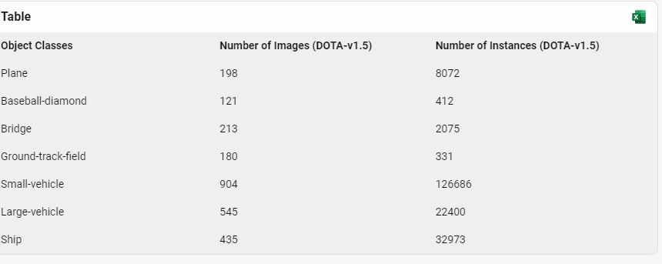
DOTA V 1.5

Slide 19
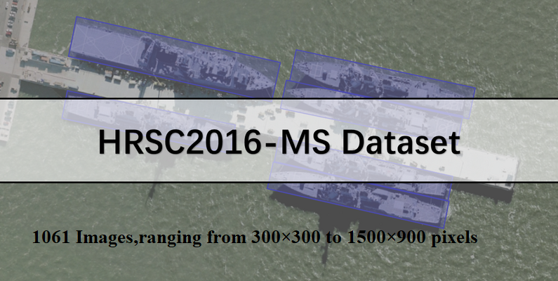
High resolution ship collections 2016-Multi Scale

Slide 20
Result
On Dota v 1.5, they obtained a large improvement of 7.5% when using the train/test split.
Furthermore, the classes with the smallest instances:
small vehicles and ships, have increased by 11.01% and 1.3%, respectively.
On HRSC2016,they have got mAP50 of 0.9059 on used PASCAL VOC 2007 (VOC07) and mAP50 of 0.9789 on PASCAL VOC 2012

Slide 21

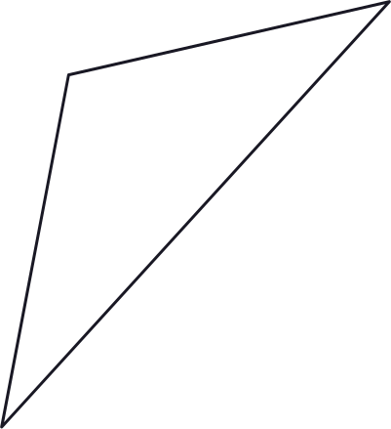
THANK
YOU

